Slide 1
Unsupervised Machine Learning
© Templateswise.com
ANKIT MIRAJKAR

Slide 2
AGENDA
Unsupervised Machine Learning
K means clustering
PCA

Slide 3
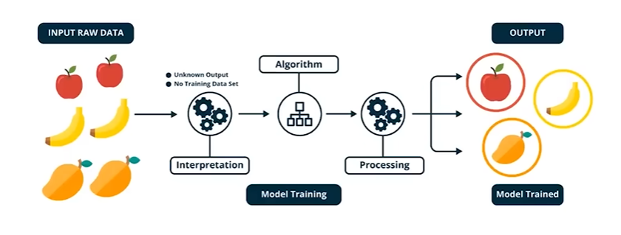
Unsupervised machine learning
Unsupervised Machine learning is a type of machine learning algorithm used to draw inferences from datasets consisting of input data without any labelled responses
Training data here is collection of information without any labels

Slide 4
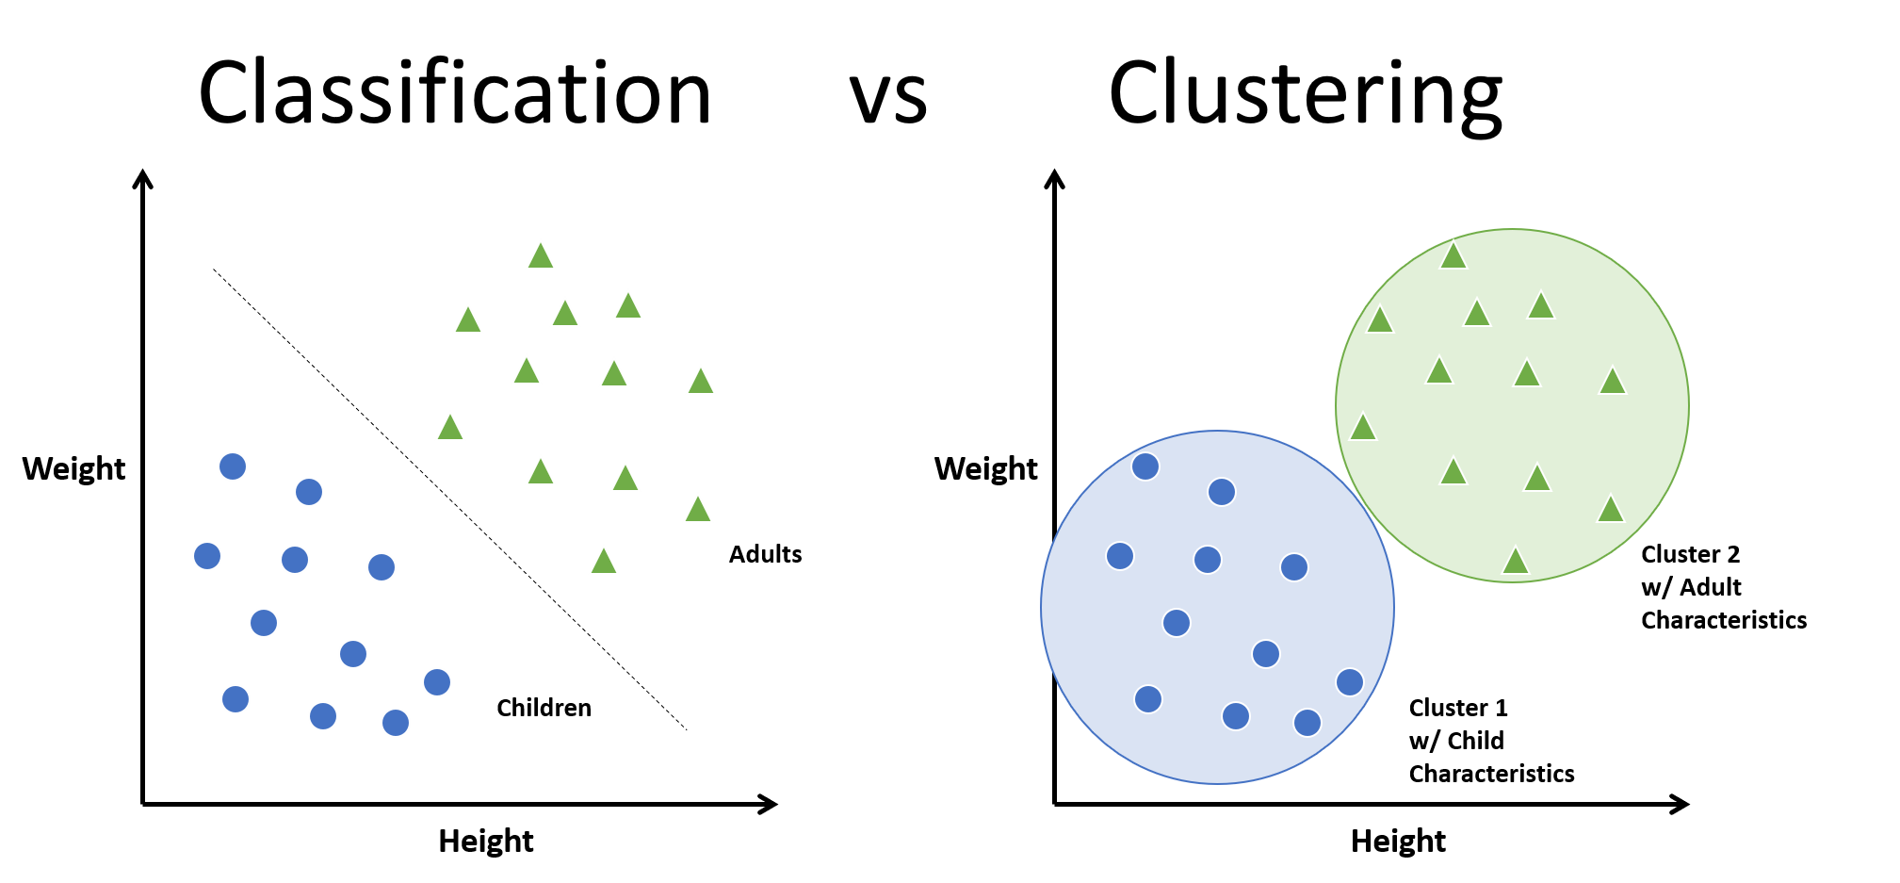
CLUSTERING
Clustering or cluster analysis is a machine learning technique, which groups the unlabelled dataset.
A way of grouping the data points into different clusters, consisting of similar data points. The objects with the possible similarities remain in a group that has less or no similarities with another group.
The clustering technique can be widely used in various tasks. Some most common uses of this technique are:
Market Segmentation
Statistical data analysis
Social network analysis
Image segmentation
Anomaly detection, etc.

Slide 5
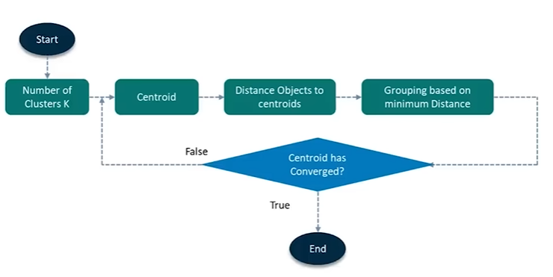
K-MEANS CLUSTERING
It is an iterative algorithm that divides the unlabeled dataset into k different clusters in such a way that each dataset belongs only one group that has similar properties.
Here K defines the number of pre-defined clusters that need to be created in the process, as if K=2, there will be two clusters, and for K=3, there will be three clusters, and so on.
It is a centroid-based algorithm, where each cluster is associated with a centroid. The main aim of this algorithm is to minimize the sum of distances between the data point and their corresponding clusters.

Slide 6
How does the K-Means Algorithm Work?
Step-1: Select the number K to decide the number of clusters.
Step-2: Select random K points or centroids. (It can be other from the input dataset).
Step-3: Assign each data point to their closest centroid, which will form the predefined K clusters.
Step-4: Calculate the variance and place a new centroid of each cluster.
Step-5: Repeat the third steps, which means reassign each datapoint to the new closest centroid of each cluster.
Step-6: If any reassignment occurs, then go to step-4 else go to FINISH.
Step-7: The model I s ready.

Slide 7
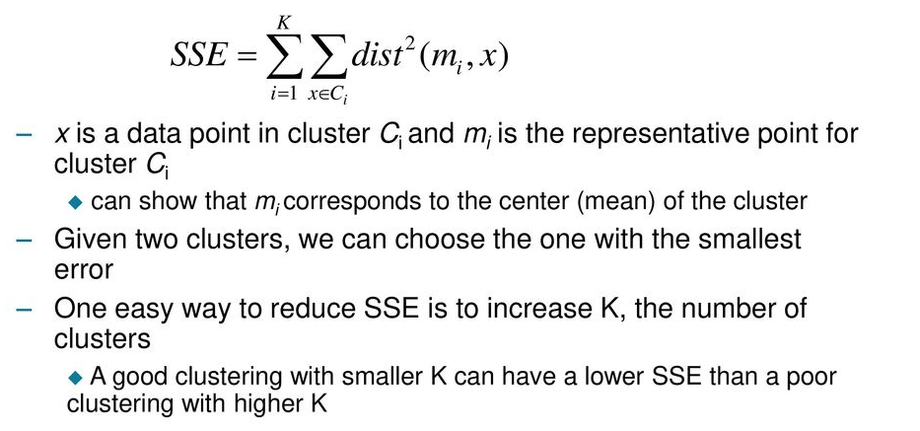
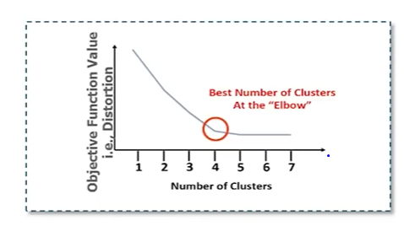
DECIDING THE NUMBER OF CLUSTERS
Elbow Method is one of the most popular ways to find the optimal number of clusters. This method uses the concept of WCSS (Within Cluster Sum of Squares) value, which defines the total variations within a cluster. The formula to calculate the value of WCSS (for 3 clusters) is given below:

Slide 8
PRINCIPLE COMPONENT ANALYSIS
Principal Component Analysis is an unsupervised learning algorithm that is used for the dimensionality reduction in machine learning.
Features:
Principal Component Analysis helps you find out the most common dimensions of your project and makes result analysis easier.
It converts the observations of correlated features into a set of linearly uncorrelated features with the help of orthogonal transformation. These new transformed features are called the Principal Components.
PCA works by considering the variance of each attribute because the high attribute shows the good split between the classes, and hence it reduces the dimensionality.
Some real-world applications of PCA are image processing, movie recommendation system, optimizing the power allocation in various communication channels.
Notes:
Consider a scenario where you deal with a project with significant variables and dimensions. Not all these variables will be critical. Some may be the primary key variables, whereas others are not. So, the Principal Component Method of factor analysis gives you a calculative way of eliminating a few extra less important variables, thereby maintaining the transparency of all information.

Slide 9
Why PCA is done?
PCA (Principal Component Analysis) is performed mainly for dimensionality reduction while retaining most of the important information. The reasons are:
Reduce Complexity
Remove Redundancy
Noise Reduction
Visualization

Slide 10
Some common terms used in PCA algorithm:
Dimensionality: It is the number of features or variables present in the given dataset. More easily, it is the number of columns present in the dataset.
Correlation: It signifies that how strongly two variables are related to each other. Such as if one changes, the other variable also gets changed. The correlation value ranges from -1 to +1. Here, -1 occurs if variables are inversely proportional to each other, and +1 indicates that variables are directly proportional to each other.
Orthogonal: It defines that variables are not correlated to each other, and hence the correlation between the pair of variables is zero.

